Slide 1

Heroin Overdose Response
Mesa, AZ
Austin Wheat, Jie Wang, Yebei Yao

Slide 2
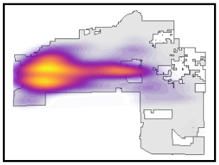
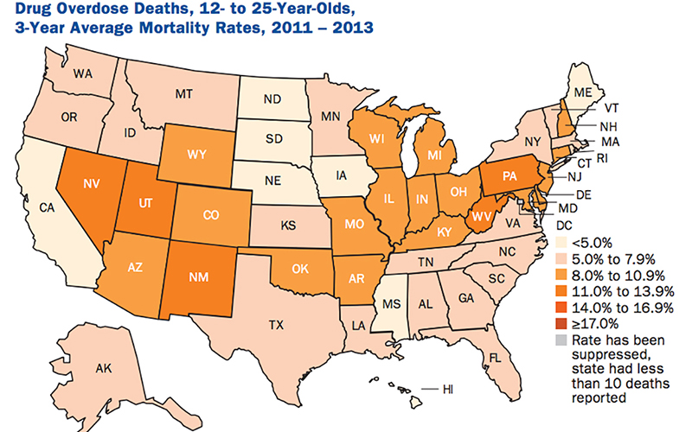
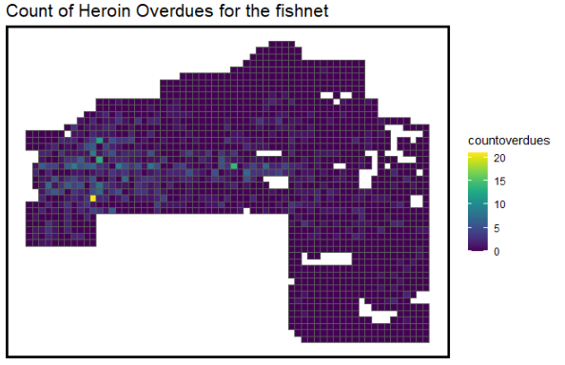
Current Overdose Condition
Density of Overdoses
Mesa, AZ
Count of Heroin Overdoses for the fishnet
Arizona has high youth drug deaths, few policies to curb them

Slide 3
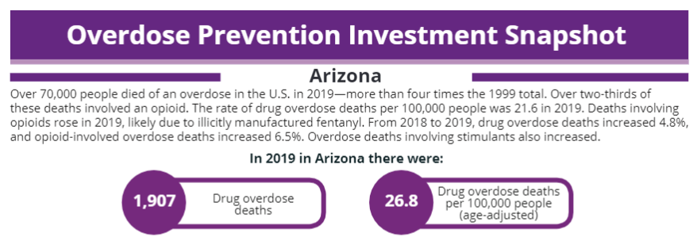
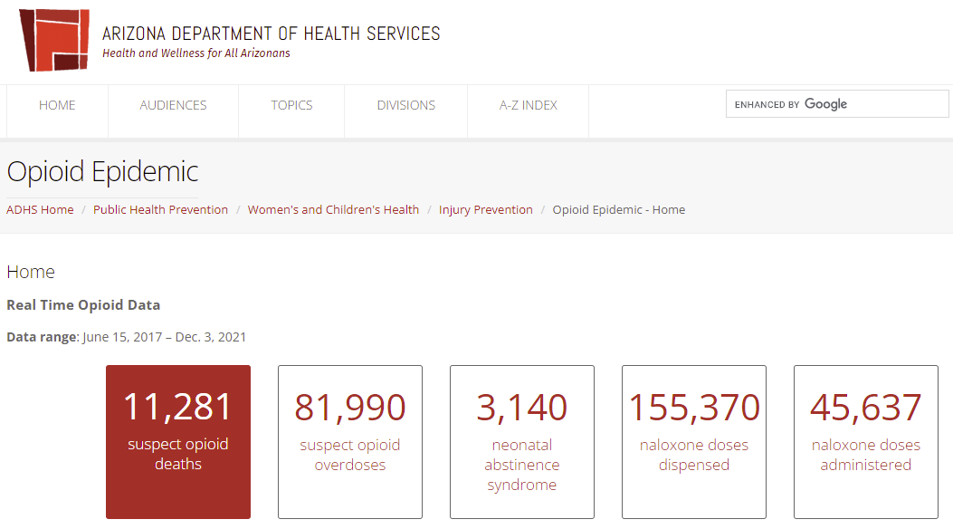
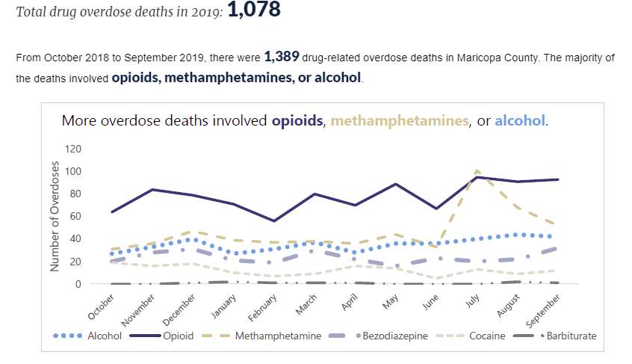
Current Overdose Condition
Mesa, AZ
Arizona
Maricopa County
Total drug overdose deaths in 2019:
1,078

Slide 4

Current Business as Usual Decision Making

Slide 5

Data source
Crimes
Street Centerlines
Police incidents

Slide 6


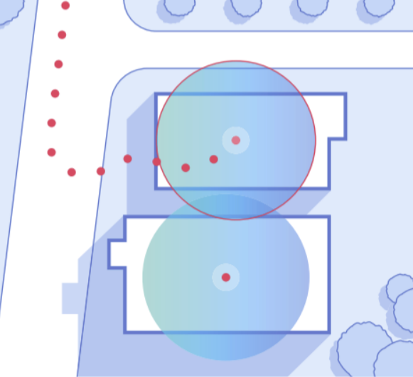
Data source
Hospitals
Bars
Liquor Stores
Rehab center
Streetlights

Slide 7
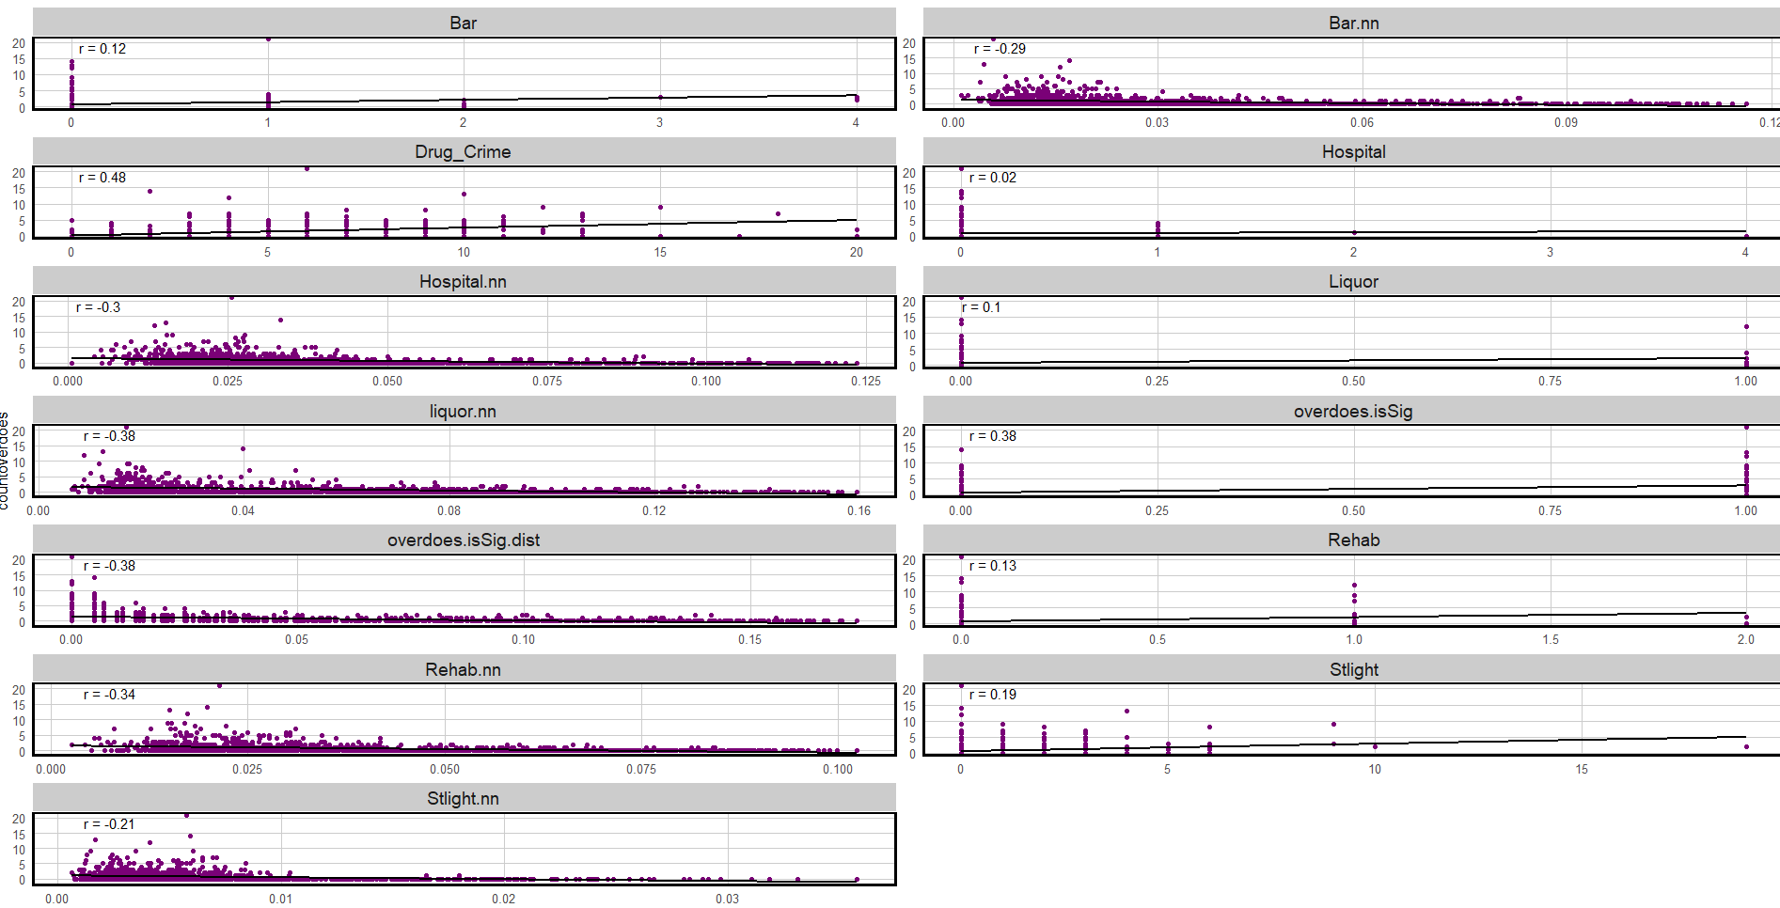
Correlations
Heroin Overdoes as a function of risk factors

Slide 8
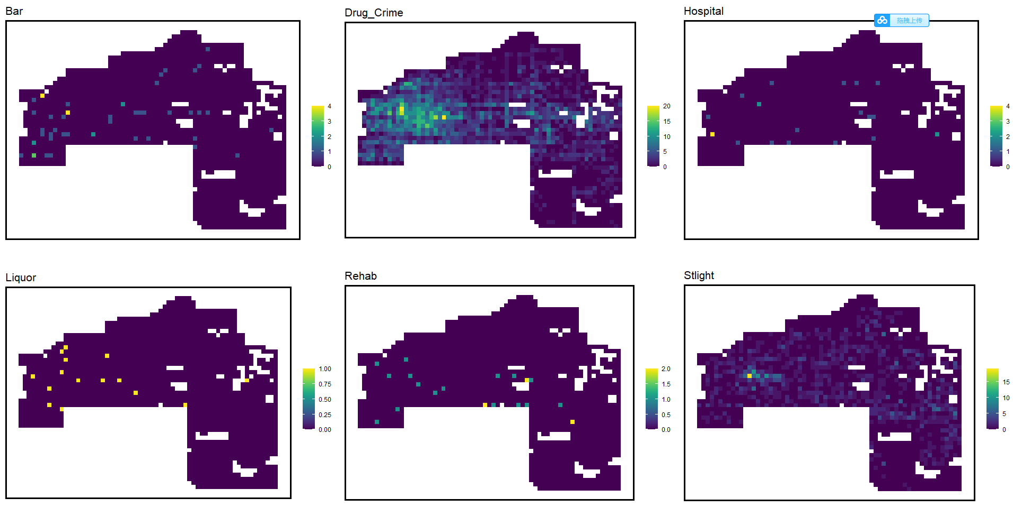
Data sets
Risk Factors by Fishnet

Slide 9
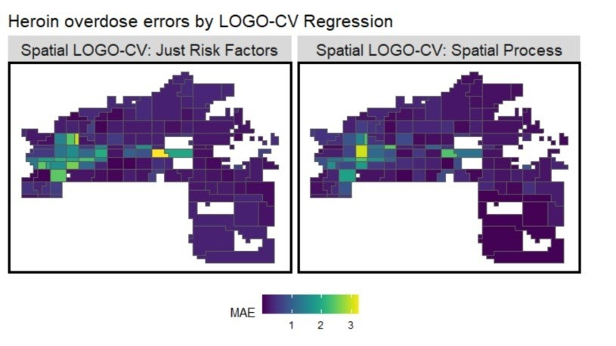
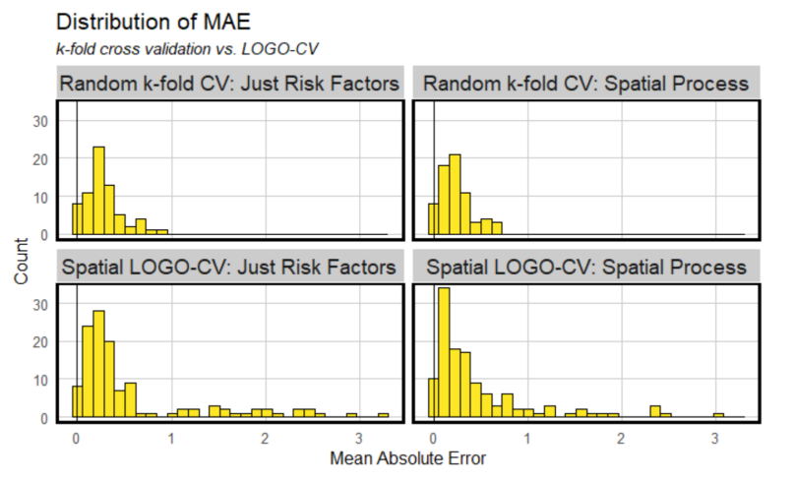
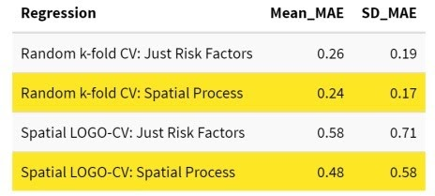
Poisson Model
&
Cross-validation
Notes:
Spatial process decreases errors. It’s

Slide 10
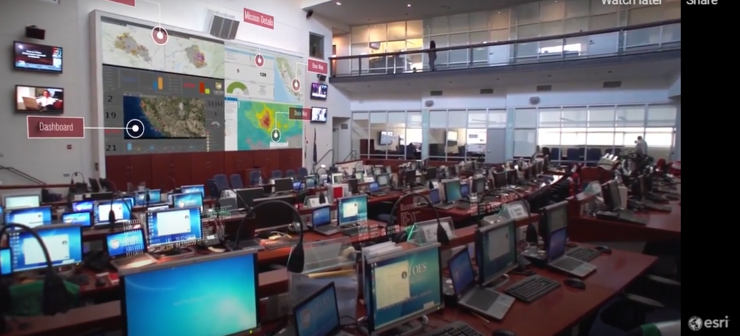
How will Stakeholders Consume this Data?
Via a dashboard that can be viewed as overdose trends change spatially

Slide 11

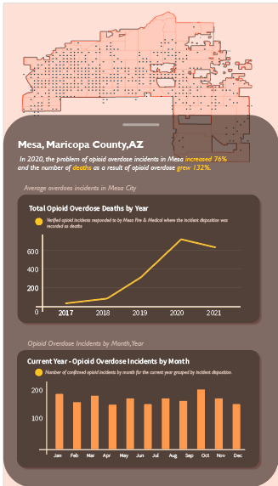
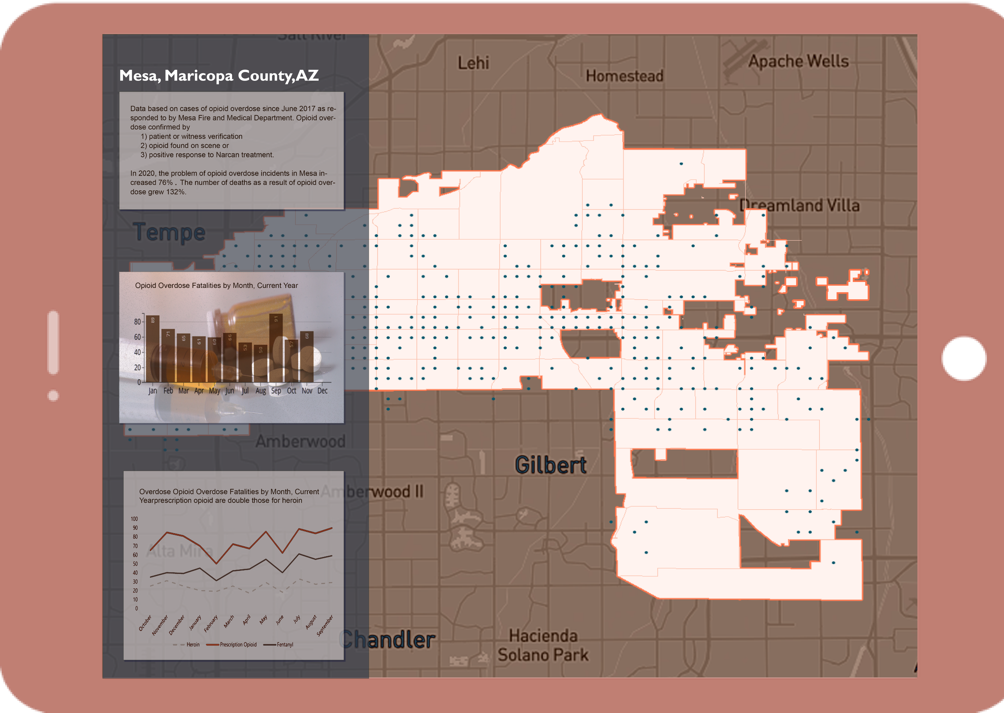
App wireframe (Page 1)

Slide 12
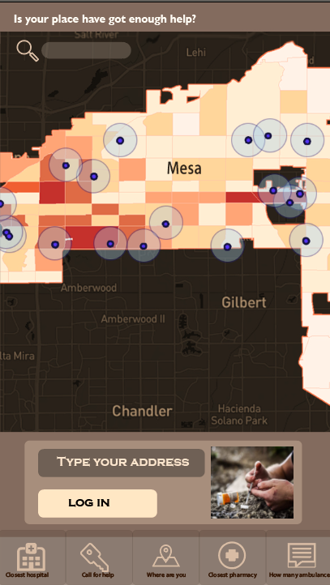
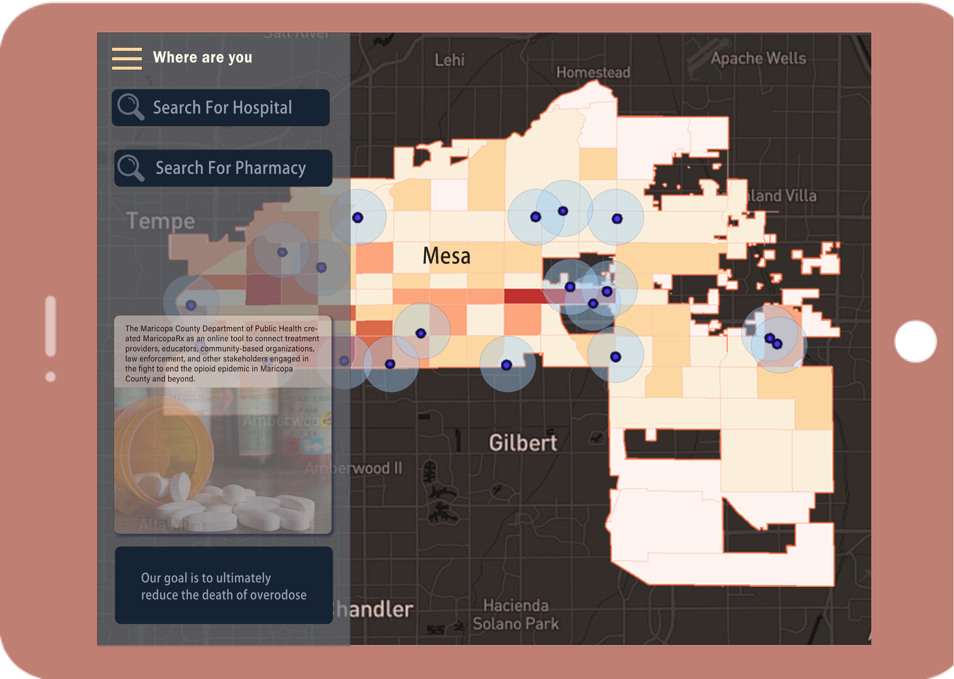
App wireframe (Page 2)

Slide 13

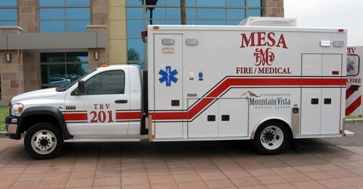
Use Cases
Use Case One: Emergency Response
Ambulance Service Reach You in Time !!!

Slide 14
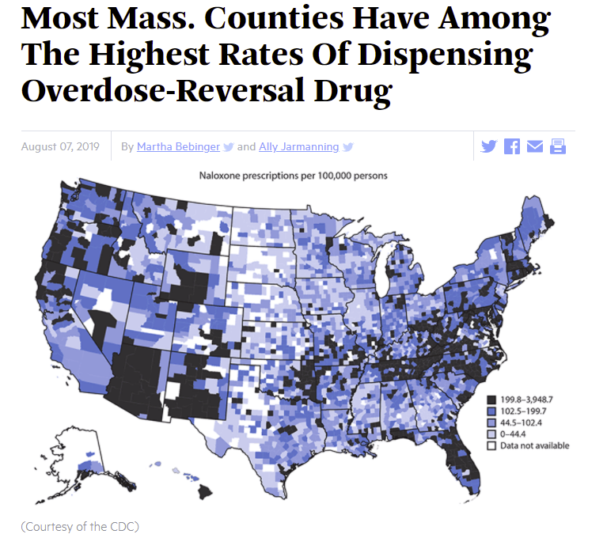

Use Cases
Use Case Two：Improve Naloxone Distribution

Slide 15
THANKS
LOCATION
CONTACT US
1760 5th Avenue
Mesa City
email@email.Com
(123) 456 7890
CONTACT
US.
OUR HOURS
MORE INFO
Sunday Until Noon
Mo-fri 8:00 – 17:00
Sunday Until Noon
Mo-fri 8:00 – 17:00
SIMPLE BUT POWERFUL.

